Slide 1
Tag Up
Emily, JJ, David, Adrienne, Troy

Slide 2
Problem
According to U.S. News & World Report, as of 2014, the University of Oklahoma’s average freshman retention rate is at 84.5% (usnews.com).
Approx. 28,966 students attended OU in 2015. That means around 4490 students dropped out last year. (15.5% of 28,966).
Students feel intimidated to reach out to new people.
Students are reluctant to talk with strangers.
Students are too busy.

Slide 3
What is Tag Up?
Tag Up is an app designed to facilitate the connection of students to peers with similar interests by setting up lunch meetings in groups of 3-5 based on details provided in the profile.
User must sign in with OU 4x4 (for privacy and safety reasons).
User creates a profile consisting of name, major, year, lunchtime availability, and interests.
User fills out a short personality questionnaire to better match them with people they would be compatible with.
App sorts users into groups of 3-5 and sets a date, location, and time for the meeting.

Slide 4
Additional Functions
OU email verification.
Campus map.
Links to other social media sites.
Group messaging.
Usage of internal GPS device to search for users nearby.
Reporting (if no-show or other reason).
Coupons (cooperating with campus restaurants).

Slide 5
Solution
Students feel intimidated to reach out to new people. → Tag Up automatically groups them up by info given and figures out a perfect lunch meeting.
Students are reluctant to talk with strangers. → Tag Up matches students with people that have common interests and personalities.
Students are too busy. → Tag Up matches them based on free time.
Lasting connections are what make a difference. → Tag Up encourages follow-up meetings.

Slide 6
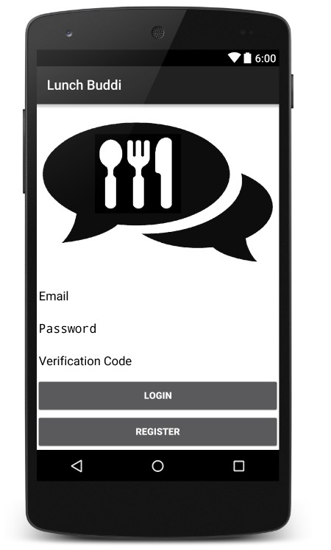
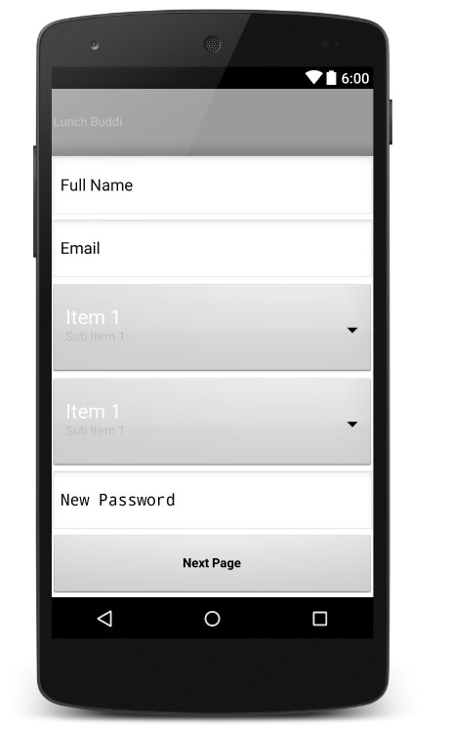
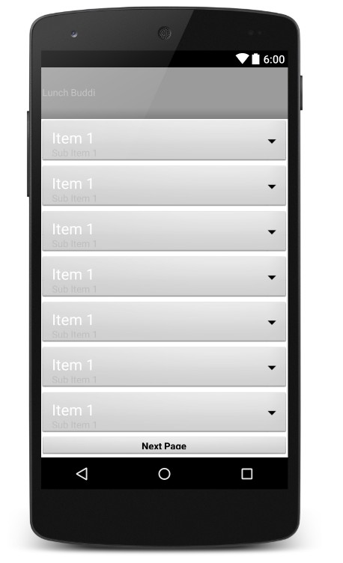
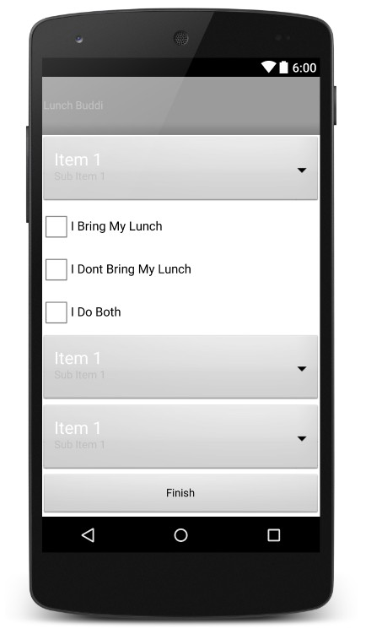
Completed (Navigable UI)

Slide 7
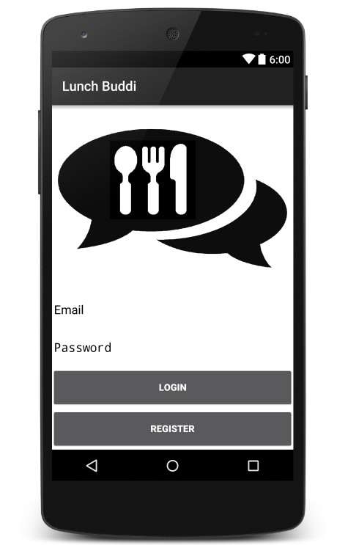
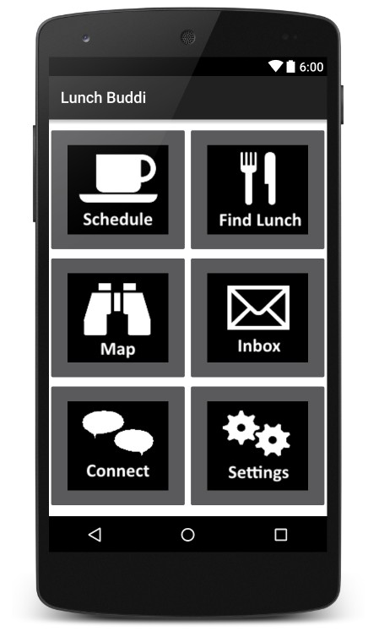
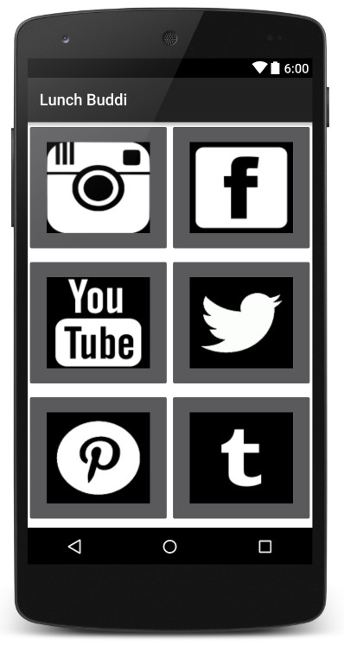
Completed (Navigable UI)

Slide 8
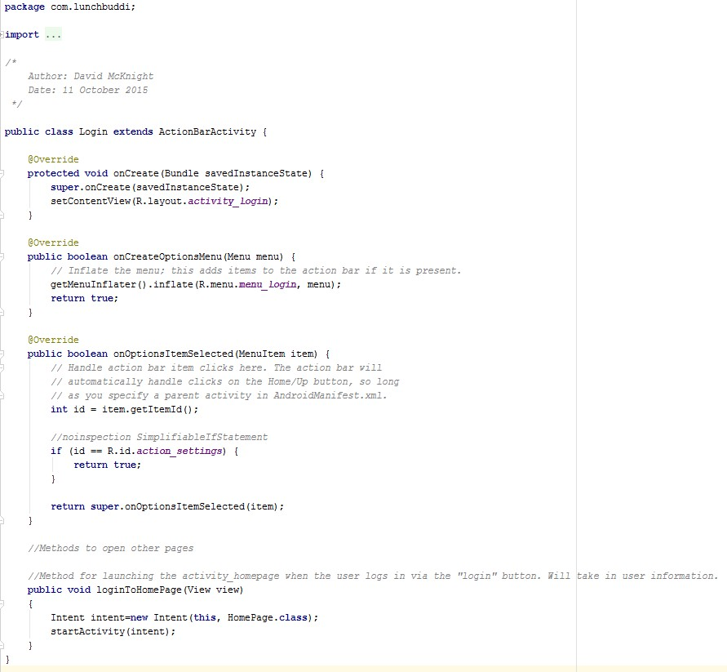
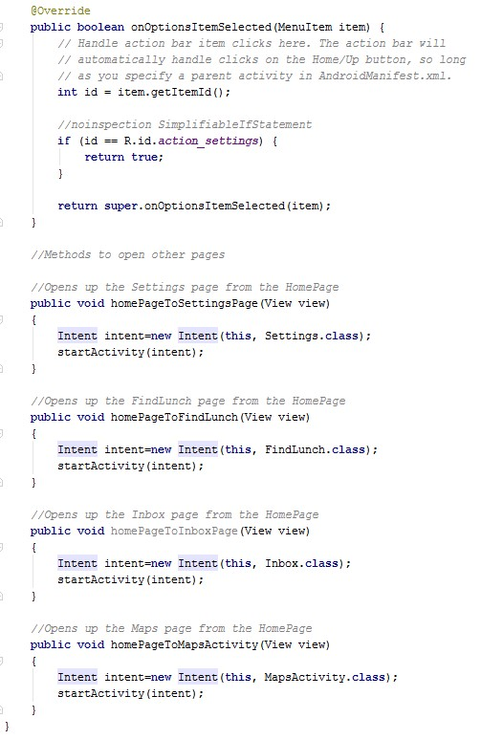
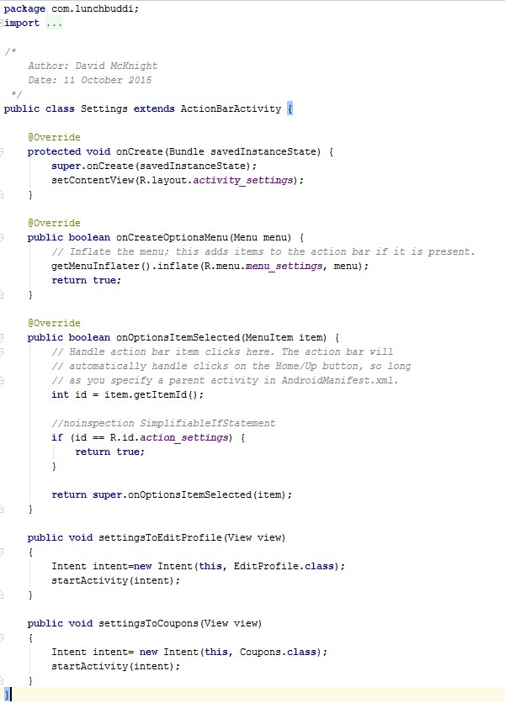
Completed (Navigable UI)

Slide 9
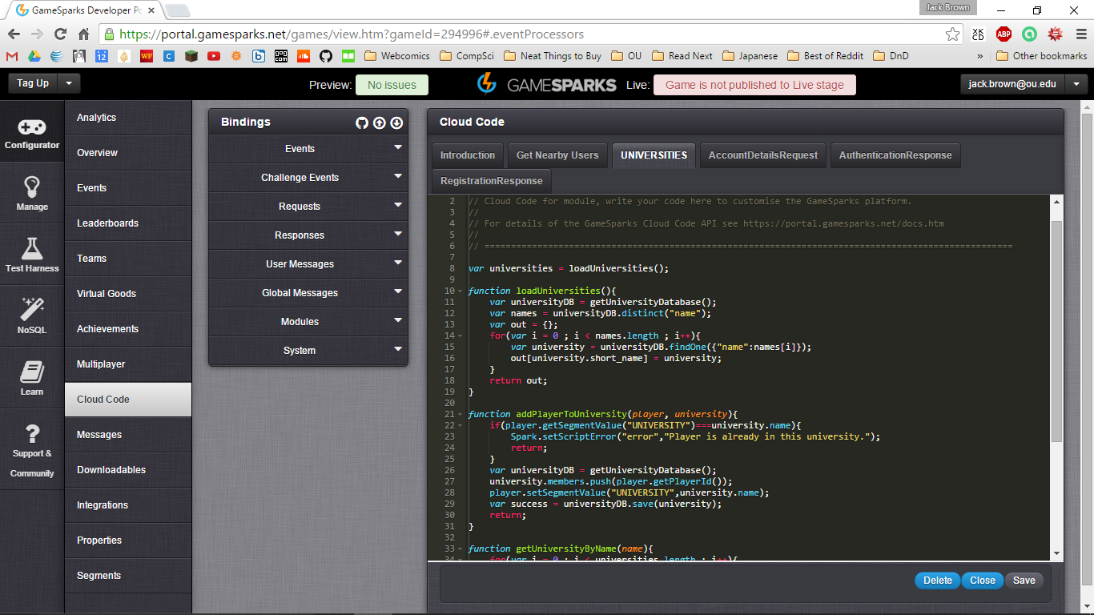
Completed (Basic Server Connection)
Chose a server.
Began connecting app to the server.
Programmed a model of how our network will interact.

Slide 10
Completed (Research)
Research how and whether our app would affect retention rates at OU.
Created a survey to get public opinion of certain aspects of our app (not yet distributed).

Slide 11
To Do:
Finish fragments for UI.
Improve on layout and structure of UI.
Distribute surveys.
Implement algorithm (backend).
Continue to work on server.

Slide 12
Sources
http://colleges.usnews.rankingsandreviews.com/best-colleges/university-of-oklahoma-3184

